Slide 1
CS 580 – Discussion HW2 & 3 Projection
Week 4
Lixing Liu
lixing.liu@usc.edu

Slide 2
Reminder: HW2
Due Tue, Sep 11
Note: if you installed VS 2015 / 2017, you’ll have .VC.db file (e.g., “CS580HW2.VC.db”) instead of *.sdf file (e.g., “CS580HW2.sdf”)
* Please delete those large files before submitting your assignment to BB
* The compressed package should be less than 1MB

Slide 3
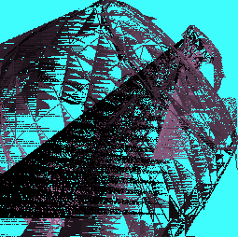
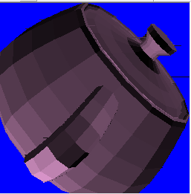
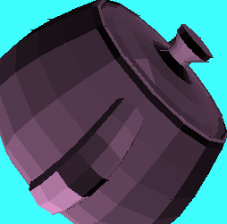
Possible issues with Scan-Line
Extra or missing horizontal/vertical lines are issues in the scan-line implementation

Slide 4
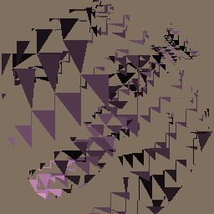
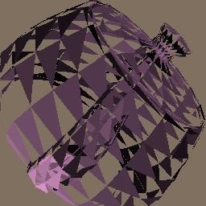
Possible issues with LEE
Missing triangles are due to not checking the LEE conditions properly
- All 3 LEE should have the same sign (>0 OR <0)

Slide 5

Possible issues with pixels falling on edges (both approaches)
If you see triangle lines: the pixels falling on edges are not properly handled:
- Pick left or right edges and include only one
- If the edge is horizontal: pick top or bottom edges and include only one
=> C code: You can use the ceil/floor commands

Slide 6
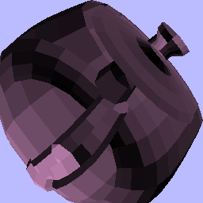

Possible issues with Z-buffering
Z-buffer not checked
Wrong Z-buffer test /
Wrong Z initialization (initial Z should be INT_MAX)

Slide 7
Z-buffering
When to do Z-buffer checking?
Pixel-wise. Each time you write to pixel:
- Interpolate Z value at pixel (Zpix)
- Compare Zpix to the current Z-value in the Frame Buffer (Zfb)
- If Zpix < Zfb,
- override existing values for pixel: color/alpha/Z
- Otherwise,
- do nothing, skip pixel – the surface is occluded!
Note: Make sure you initialize the Z-buffer (to INT_MAX)!

Slide 8
Goals of HW 3
1. Change the viewpoint of the camera
Default view
Novel view

Slide 9
Goals of HW 3
2. Enable transformations on the teapot
RotX = 30°
RotY = 30°
RotZ = 30°
Tr=[1 1 1]
Scale=[.5 .5 .5]

Slide 10
Environment setup
Open the CS580HW3.dsw file (and upgrade to .sln)
Copy and Paste your previous implementations in the proper sections in rend.cpp
Don’t modify the MFC APIs in application3.cpp or introduce any 3rd party APIs.

Slide 11
Goal 1: Camera view
screen Xsp perspective (NDC) Xpi image Xiw world Xwm model
Xwm object positions (per frame or per instance)
Xiw camera position and orientation (per frame)
Xpi camera FOV (focal length or zoom) (per frame)
Xsp mapping NDC image to frame-buffer (per frame)
HW2: vertex coordinates were in screen coordinate.
HW3: vertex coordinates are in model coordinate.
Note: To go from model coordinate to screen coordinate,
you need to multiply by XspXpiXiwXwm.

Slide 12
Goal 1: Camera view
The camera structure is defined in gz.h
typedef struct {
GzMatrix Xiw; /* xform from world to image space */
GzMatrix Xpi; /* perspective projection xform */
GzCoord position; /* position of image plane origin */
GzCoord lookat; /* position of look-at-point */
GzCoord worldup; /* world up-vector (almost screen up) */
float FOV; /* horizontal field of view */
} GzCamera;

Slide 13
Goal 1: Camera view
GzPutCamera:
- Set the camera parameters of render->camera
Position
Lookat
worldup
FOV
- Compute Xpi, Xiw

Slide 14
Goal 1: Camera view
In rend.cpp, you will need to implement:
GzPushMatrix // Pushes a matrix on the stack
GzPopMatrix // Pops a matrix from the stack
- Then you will need to push in that order:
Xsp*
Xpi*
Xiw*
Xwm
*When initializing the display: GzRender

Slide 15
Goal 1: Camera view – stack operations
GzPushMatrix:
- If the stack is empty
Add the matrix
- Otherwise
Multiply the new matrix by the top of the stack and push it into the stack
- Increment matlevel
GzPopMatrix:
- Decrement matlevel

Slide 16
Goal 1: Camera view – stack operations
You will need to apply the set of transformations to every vertex of every triangle in GzPutTriangle before rasterizing.
Note: Top of stack is Ximage[matlevel]
Warning: ignore triangles that are behind the view plane:
skip any triangle with a negative screen-z vertex
Warning: Z-interpolation should be in screen space

Slide 17
Goal 2: Object transformations
Simply create the transformation matrices in rend.cpp:
- GzRotXMat // Rotation around X-axis
- GzRotYMat // Rotation around Y-axis
- GzRotZMat // Rotation around Z-axis
- GzTrxMat // Translation
- GzScaleMat // Scaling
- Warning: You need to convert the angles from degrees to radians: multiply by p/180

Slide 18
HW3 pitfalls
Do not forget to set default camera
Careful when implementing dot, cross products and matrix multiplications
Convert angles from degrees to radians
Do not forget to apply the stack to every vertex before passing on to the rasterizer
Use homogeneous coordinates: careful when converting 4-D to 3-D vectors.
[x y z w]T => [x/w, y/w, z/w]T
ignore triangles that are behind the view plane: skip any triangle with a negative screen-z vertex
Z-interpolation should be in screen space

